Slide 1



Junior Design
Poth Nirdeshika: A Web based Project
Path Destination in app calling and messaging
Group Members
Md Saiyem Raiyan
2012468042
Sheikh Mohammed Wali Ullah
2021186042

Slide 2
Overview
Overview
Understanding the problems
Path Problems
How to solve
Which features
Which used for building
Solution analysis
How project works
Solution of the problem
Features
Technology Used
Analysis of the Solution
Workflow
Cycle Diagram
Project timeline
Conclusion

Slide 3
Introduction
“Poth Nirdeshika” A multi platform web based project
Provides the users with systematic information regarding path, road and so on about one place to another. For example it can show all possible ways and optimal paths to anyone.
Why?
Any person can easily move from one place to another without hassle.
Users will be able to see the all possible way via google map.
Call or message any expert in any kind of location.
By cross discussion with experts and their suggestions.

Slide 4
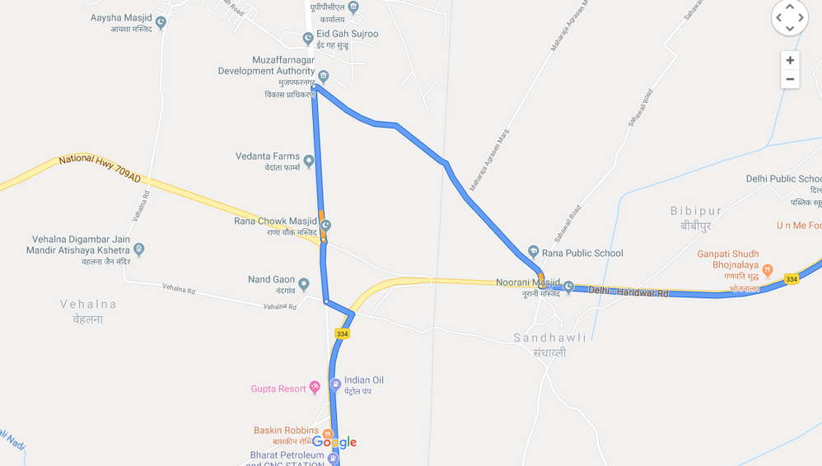
Problem Statements
01
Routes may be incorrect
02
Routes can be blocked due to some technical issue
03
Many routes option issue
04
Some of the routes can be blocked due to VIP movement

Slide 5
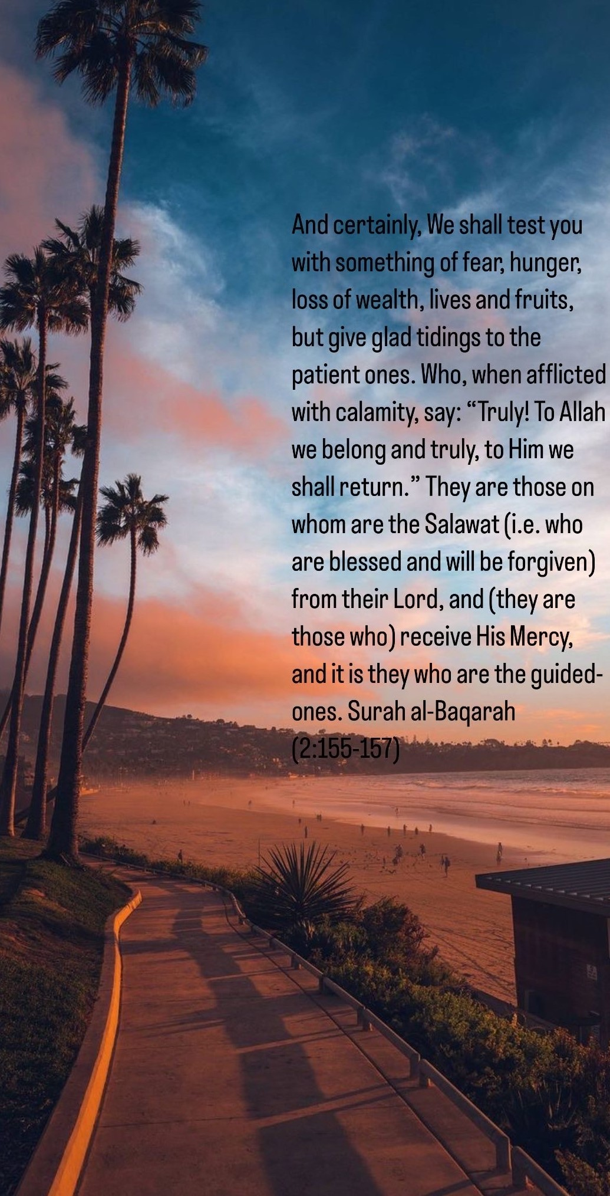
Solution
1
There will be some experts in our website who can help you to verify the routes
2
By communicating with the experts, any user can get information about the technical blockage or VIP movement in some routes
3
Expert can also help to select among routes using their previous experience
4
There will be some extra feature implemented in our project which will allow the user to contact with expert, make a wise decision and have a smooth journey

Slide 6
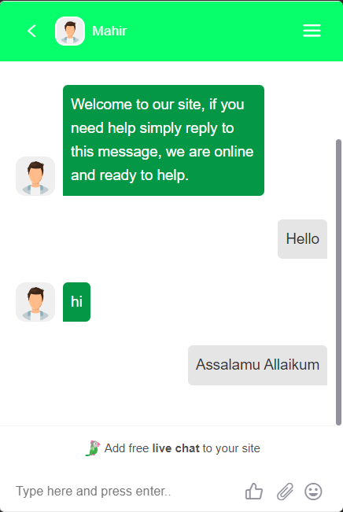
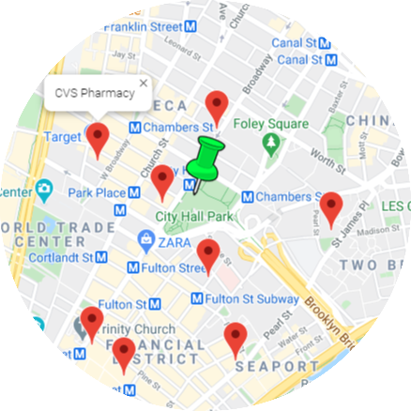
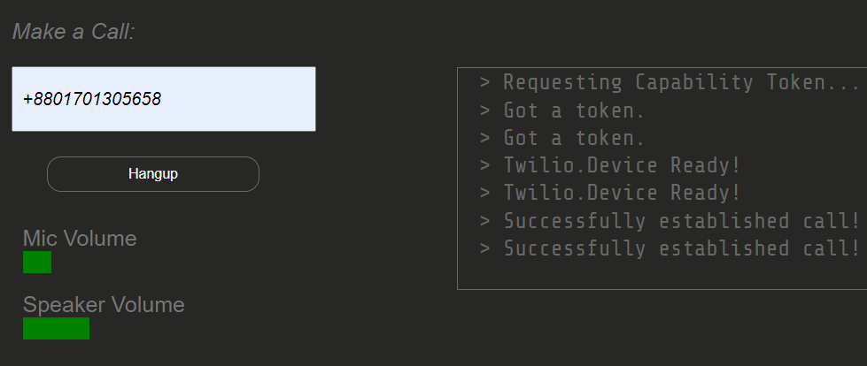
Features
Calling experts: User can call an experts from the website. User doesn’t need to have a phone no. to call. He or she can use our built caller page.
*
Chatting with experts: user can use chat to get suggestion from experts using a via method of admin. User doesn’t need to created any kind of chatting account for that
Routes form the usual map: The current google maps routes will also be shown to our website. User can search for routes.
Choosing any experts from the given map related to user’s route.

Slide 7
Technology Used
Frontend
HTML
CSS
BootStrap
Backend
PHP
JavaScript
Plugin of Tawk.to
API
Google Map
GMap Geolocation
GMap Routes
GMap Places
GMap Directions
25%
45%
25%
5%
Frontend
API
Backend
DBMS
Twilio API for call feature
Tawk. to API for Chat Features

Slide 8

Difficulties
Response from the google maps sever blocked: Billing account & some amount of money
Call API from twilio problem: Regional restriction & paid subscription needed

Slide 9
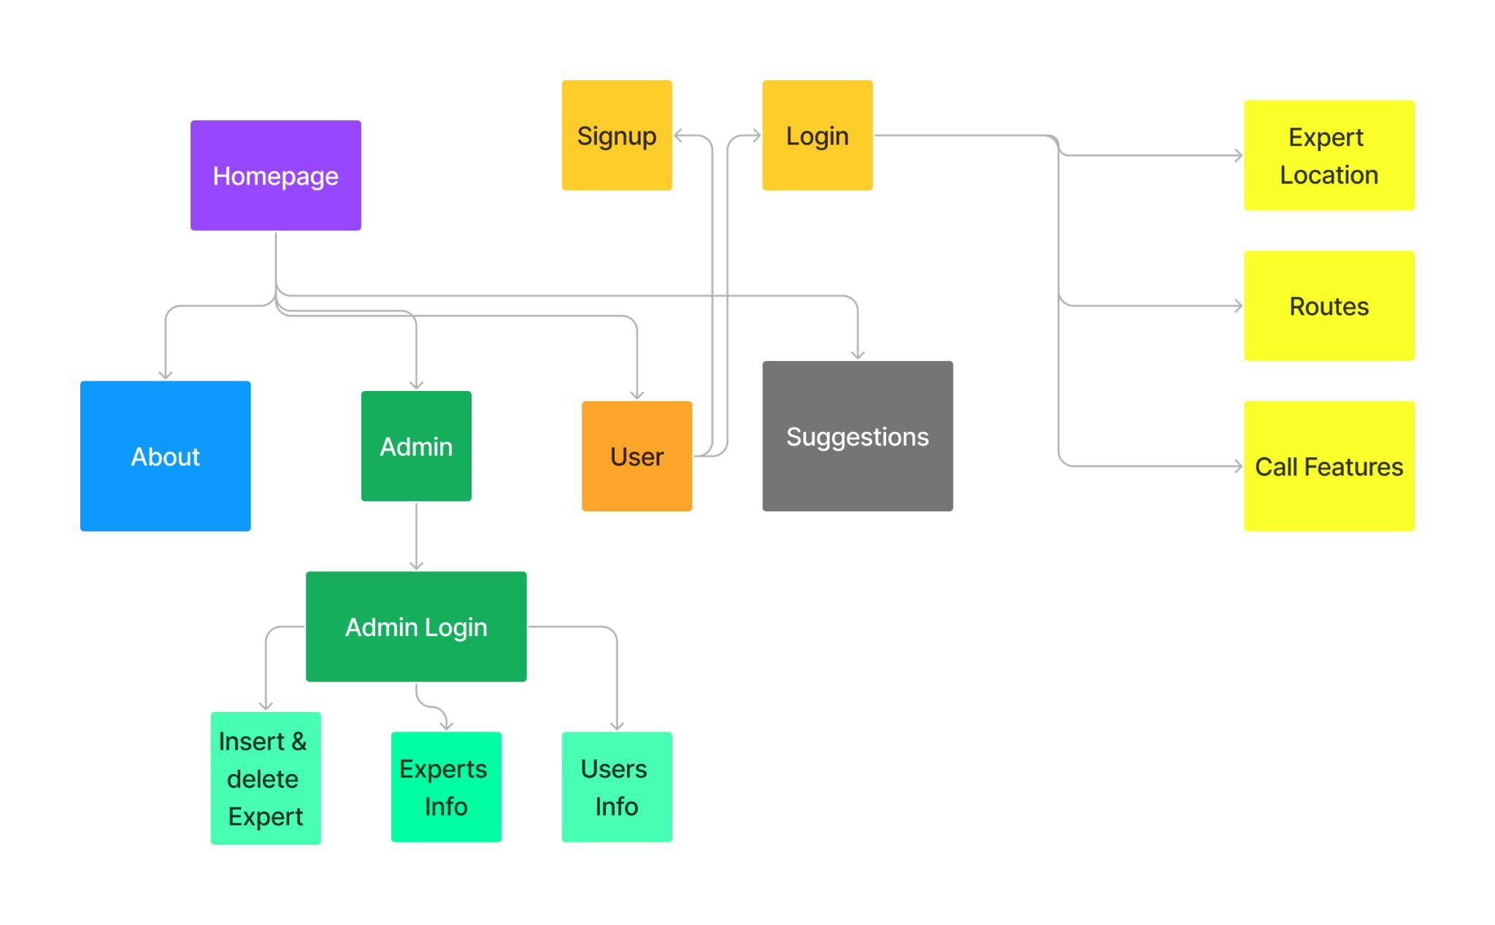
Workflow

Slide 10
Cycle diagram
04
Initiation Phase
Project Phase
Project Definition- Project Constraints and project Statements
Monitoring, Controlling, Closure and review
01
03
Planning Phase
Execution Phase
Detailed Planning: Estimation and scheduling
Acquisition, Development and management
02

Slide 11
Project Timeline
FEB
MAR
APR
MAY
JUN
Suggestions Expert
Login & Signup
Path Showing
Calling Expert
Chat
Database, Login and signup form and cross checking with database
Expert Position, Route, optimal path implementation
Implement suggestions from expert via messaging
Call feature implementation via twilio API
Messaging with users and experts

Slide 12
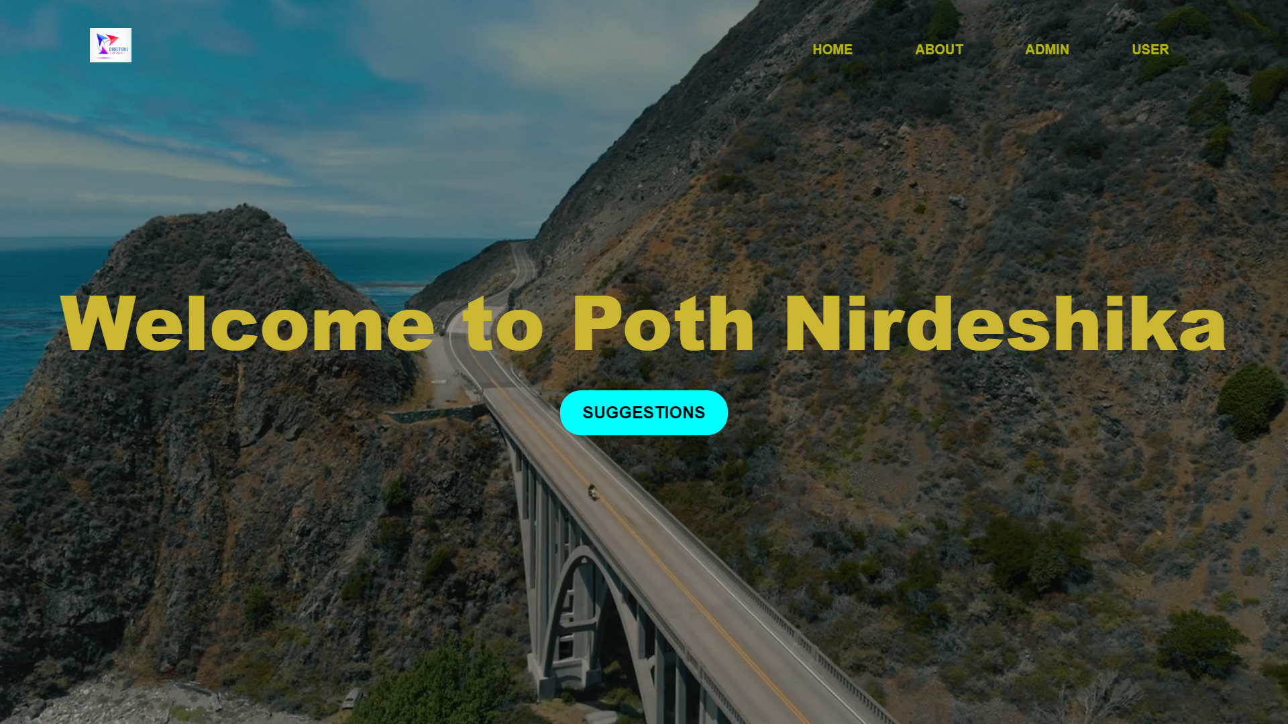
Conclusion
Simplify and enhance the process of moving from one place to another by providing access to path experts.
Navigation effortless for individuals by offering a user-friendly platform
Tries to optimize travel time and minimize delays
People can access accurate and up-to-date information about the best routes, modes of transportation, and any potential obstacles along their desired paths
Encouraging collaboration between users and path experts
Promotes knowledge sharing and community engagement, contributing to the growth of a network of informed travelers
Strives to revolutionize the way people move by leveraging technology and human expertise, making journeys seamless, enjoyable, and stress-free.

Slide 13

Thank you!

